Slide 1
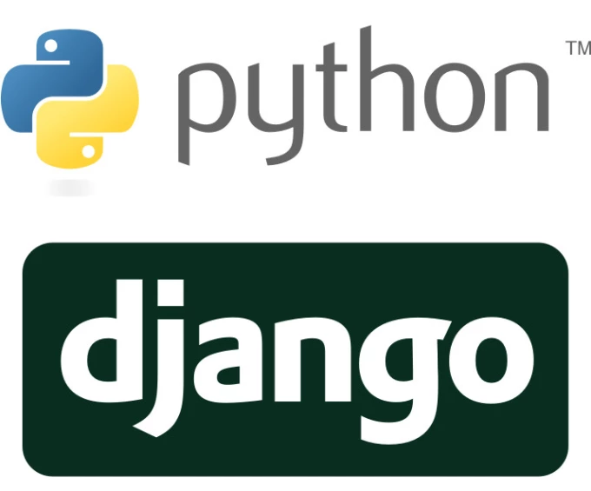
Django
Johnatan Garzón M.

Slide 2
Guide
What is?
The Structure
Django’s Models
Django’s Templates
Django’s Views
Who use Django?
Advantages
Disadvantages
Django vs. Flask
Let’s start

Slide 3
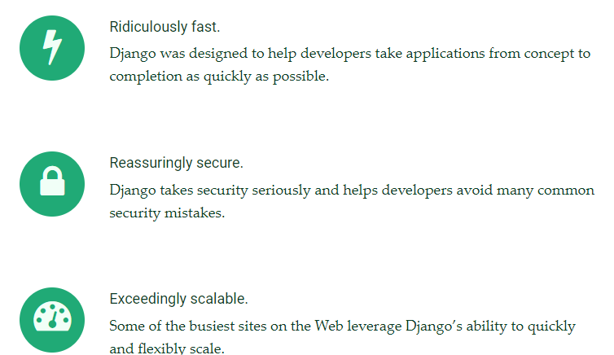
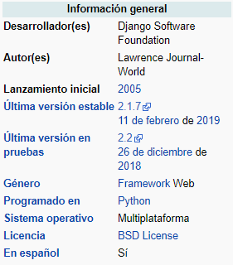
What is?
Django is a high-level Python Web framework that encourages rapid development and clean, pragmatic design.
It’s free and open source.
Notes:
Cross site scripting (XSS) protection,Cross site request forgery (CSRF) protection,SQL injection protection,Clickjacking protection

Slide 4
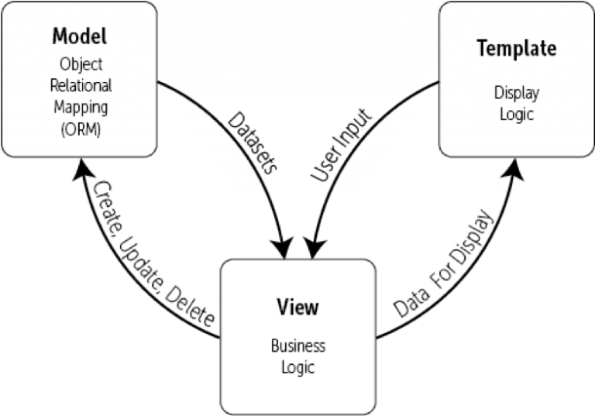
The structure

Slide 5
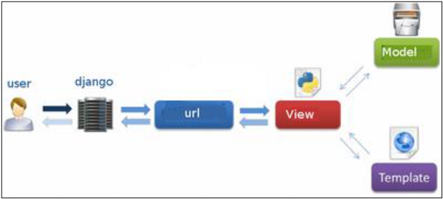
Django itself takes care of the Controller part (Software Code that controls the interactions between the Model and View), leaving us with the template. The template is a HTML file mixed with Django Template Language (DTL)
The developer provides the Model, the view and the template then just maps it to a URL and Django does the magic to serve it to the user.

Slide 6
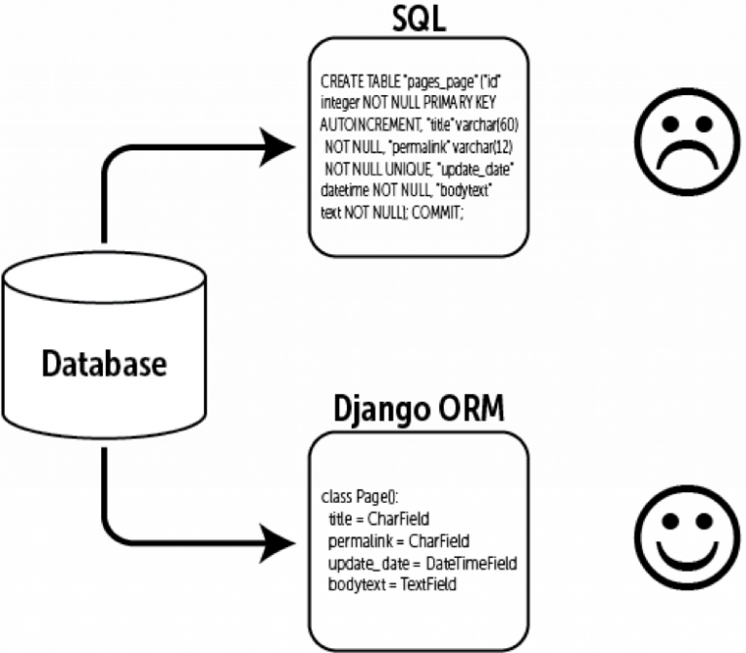
Django’s Models

Slide 7
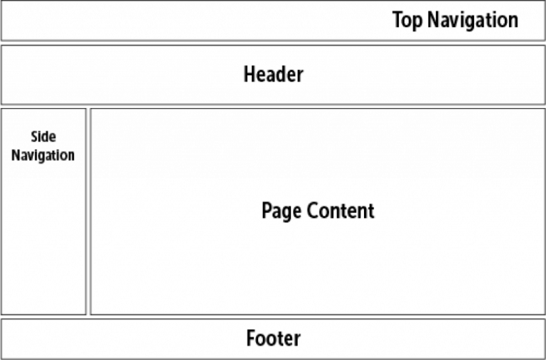
Django’s Templates
The template layer is used to separate the data from the way it’s actually presented and viewed by the user.

Slide 8

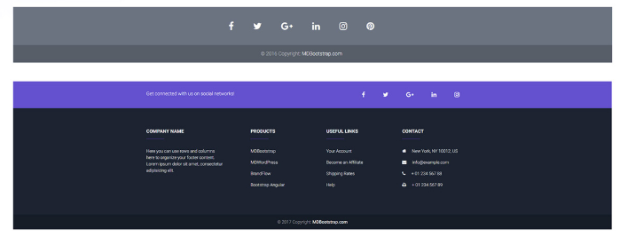
DRY (Don’t Repeat Yourself)
Your template, for example, should be divided into reusable components such as the side navigation bar, the main navigation bar, the header of the page, the footer of the page and so on. This minimizes repetition and makes for writing efficient and cleaner code.

Slide 9
Django’s Views
This is the business logic layer.
It’s responsible for processing the user’s request and sending back a valid response.

Slide 10
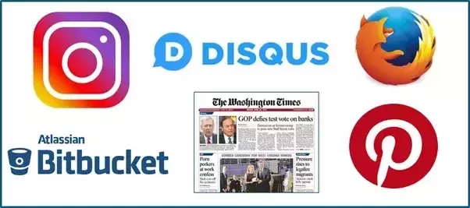
Who use Django?

Slide 11
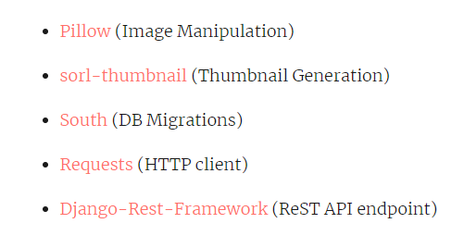

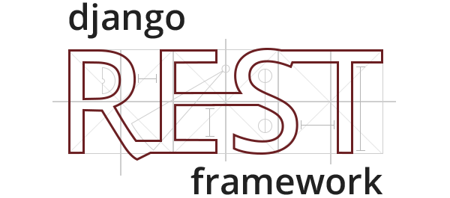
Advantages
Batteries included
Django prides itself as a batteries included framework. What that means is that it comes with a lot of stuff out of the box, that you may or may not use depending on your application. Instead of having to write your own code (the power), you just need to import the packages that you want to use.

Slide 12
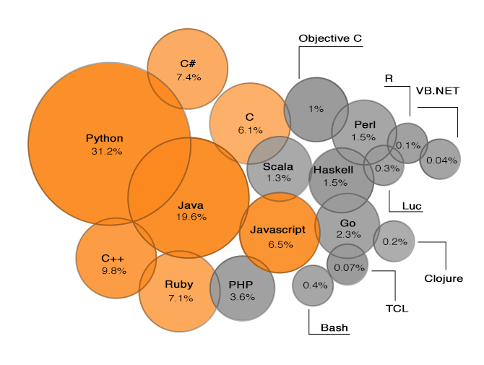
Python
Since Django uses Python, it leverages some of the fame and power of python to its own benefit.

Slide 13
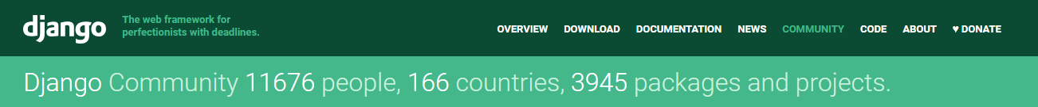
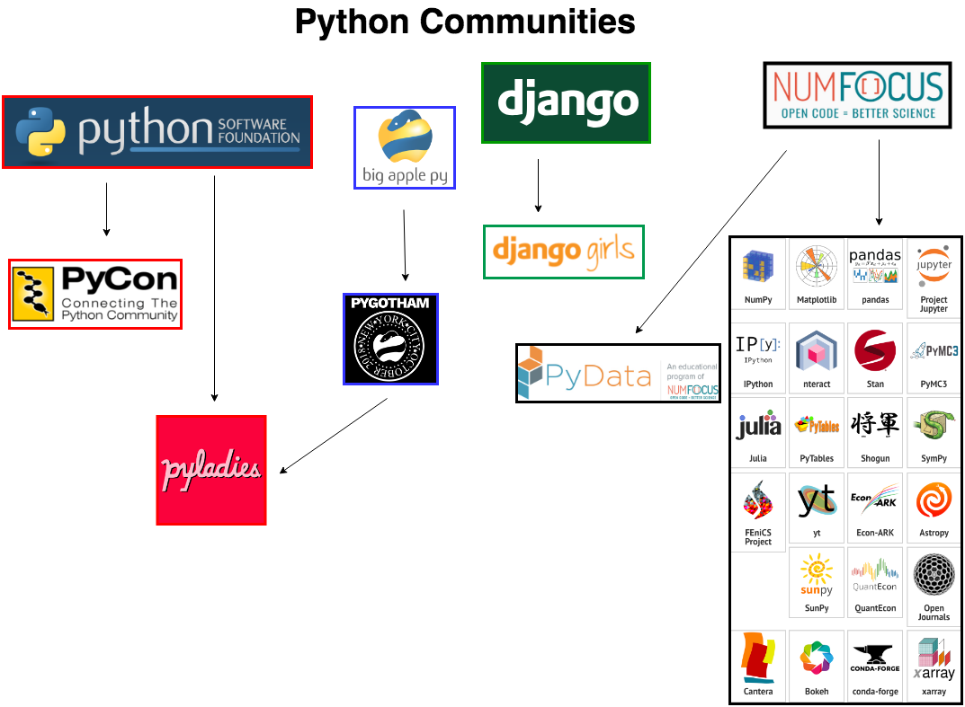
Community
Django’s community is one of the best things about it, they are helpful and actively working on making the framework more beginner-friendly and stabilizing the framework while adding new features.

Slide 14
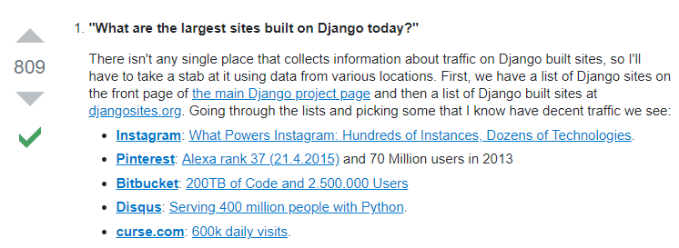
Scalable
Running separate servers for the database, the media and the application itself or even use clustering or load-balancing to distribute the application across multiple servers.

Slide 15
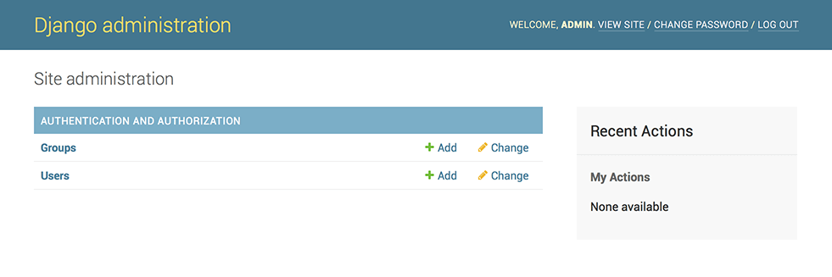
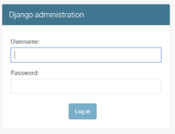
Built-in Admin
Django offers an administrative interface right out of the box that is both professional and versatile, according to the documents the developer can now develop with the presentation in mind.

Slide 16
Disadvantages
Regex URLs
It feels a little bloated for small projects some people find it quite populated with big projects since models, for example, are all included in a single file.
Template errors fail silently by default
Notes:
Template errors fail silently by default, so if you don’t know that, you might waste a lot of time trying to figure out what’s wrong with the application, or even worse, you might not even know that your application has a problem. It’s also a strongly opinionated framework, which gives it a monolithic feeling. There’s one popular and advised way of doing things and you’re supposed to follow it.

Slide 17
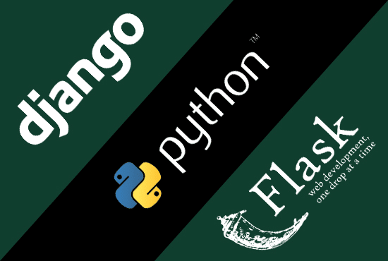
Django vs. Flask

Slide 18
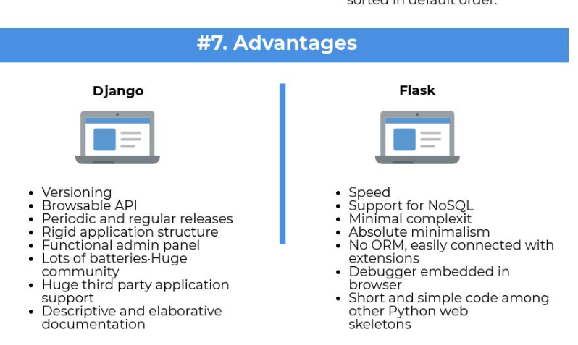
Notes:
Miniframework

Slide 19
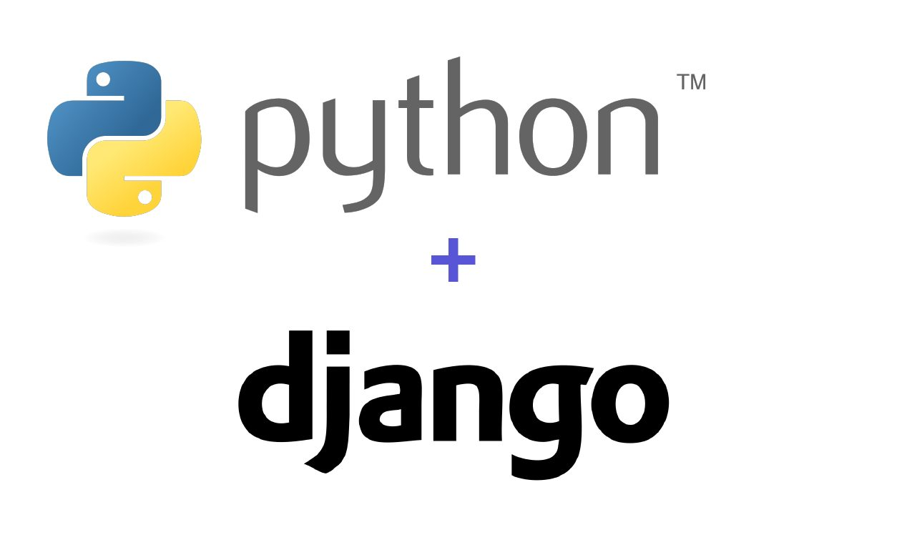
Let’s start

